Slide 1
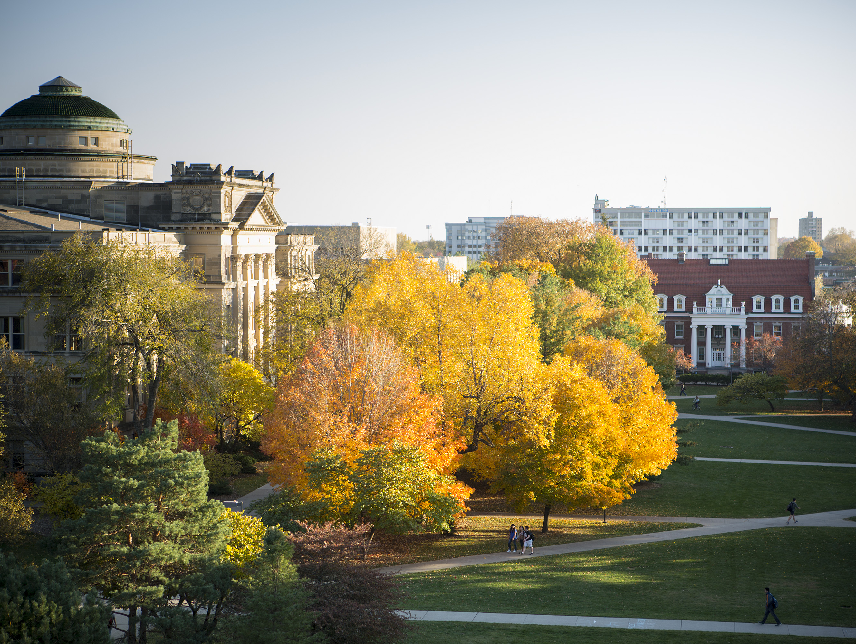

Research Task 3
Kalman filters and relevance to Ferreira (2017)
Craig Orman, intended for Dr. Farzad

Slide 2
Kalman Filter For Time Series

Slide 3
Contact Us
Name Here
Title Here
email@iastate.edu
(515)-294-1234
www.unit.iastate.edu
Name Here
Title Here
email@iastate.edu
(515)-239-1234
www.unit.iastate.edu
Name Here
Title Here
email@iastate.edu
(515)-239-1234
www.unit.iastate.edu

